Slide 1






Aspirations
2020-2021

Slide 2
Why are we doing this?
To think about your future and what you might want to do when you leave school
To let your teachers know the topics you are interested in learning more about
To set yourself some goals to improve skills or characteristics

Slide 3
How will this information be used?
If we know more about your background, interests and aspirations, we can use this to plan:
  Career events
  Co-curricular clubs
  Assemblies/form time activities
  …and much more!
We can also use your responses to provide you with more useful advice about your future and next steps

Slide 4
We will be completing the quizzes one at a time. Stay with the class.
Read each question carefully. If you are unsure what a question means, raise your hand and ask the teacher.
Give as much information in the answers as you can and be very honest. This will help school to give you the right support.

Slide 5

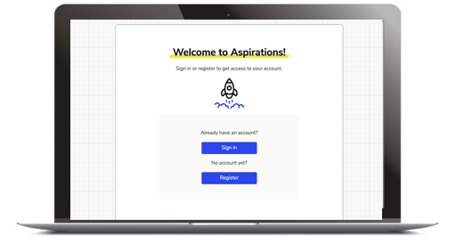
3 minutes
https://myaspire.app
Click sign in and enter your school email and password (or register to create one, if it’s your first time logging in)
If you can’t remember your password, click ‘password reset’ and it will be emailed to your school email address.
Check: Have you spelt your email address correctly?!

Slide 6
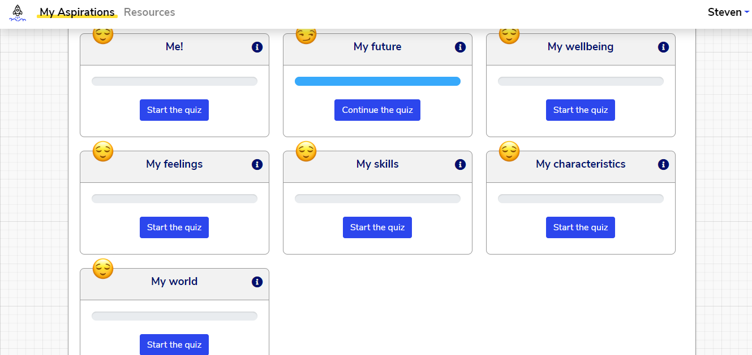
4 minutes
Quiz 1: Me!
This quiz is all about you, your friends, and your life outside of school—helping us get to know you a bit better
Class discussion:
Who are your role models, or people in your life that you look up to?
What traits do you admire in them?
Class discussion:
What do you like about your friends?
What do you think people like most about you? What do they appreciate about you?
Click Start the quiz
Notes:
Teacher Notes
- Students may struggle with the word ‘traits’, ask if anyone can provide a definition.
Give an example of a role model you look up to and discuss the traits you admire.
For example:
A friend who has been through a difficult time their self but has still been there for you when you’ve needed them. You admire their selflessness, loyalty and friendship.
Someone you know that is a talented musician or sportsperson. You admire their creativity or sports ability as well as their dedication to taking the time to practice and ambition to be successful.

Slide 7
4 minutes
Quiz 2: My future
This quiz explores your plans for the future. We’ll use your answers to shape the careers advice and opportunities we provide.
Class discussion:
What industries do you think you might like to work in?
Let’s think of the kind of jobs that come into:
Hospitality, catering and events management
Engineering and manufacturing
If you’re unsure about an industry, ask!
Click Start the quiz
Notes:
Teacher Notes
- Encourage students to think outside the box, for example catering doesn’t just mean being a chef!

Slide 8
4 minutes
Quiz 3: My wellbeing
This quiz is all about your health, safety, self-belief, and other things to do with wellbeing. Your answers will help us understand you better, so that we can support you if needed.
Some of your teachers will see your answers but none of your classmates will.
Answer these questions as honestly as you can. There is an
option for if you don’t feel comfortable answering any of the questions right now.
Click Start the quiz
Notes:
Teacher Notes
Ensure students are aware that their answers will only be seen by specific teachers and they should answer honestly and openly.

Slide 9
3 minutes
Quiz 4: My feelings
This quiz is all about your feelings. Think about how you have felt over the past 2 weeks before answering.
Some of your teachers will see your answers but none of your classmates will.
Click Start the quiz
Class discussion
What does it mean if someone describes you as optimistic?
Can you give an example of when you might be ‘thinking clearly’, or when you might not be?
Notes:
Teacher Notes
Give an example of what it might mean to be ‘optimistic’ (seeing the bright side in a situation, for example it’s raining so rugby training is cancelled but at least I can play the new game on my x-box)
Questioning: ask for examples of optimism or thinking clearly.

Slide 10
5 minutes
Quiz 5: My Skills
This quiz is all about which skills you feel you are good at and where you would like to improve. We’ll use the information to plan activities that you and your classmates want to do.
Class discussion
What does ‘self-development’ mean?
What might someone who is very good at self-development do?
Click Start the quiz
Notes:
Teacher Notes
Discuss what is meant by ‘skills’ and specific ones such as ‘self-development’.
Talk about goal setting and how students may be doing it without realizing, for example if they are aiming to get onto the school football team so attend practice each week or aiming to get a good GCSE grade so complete all their homework etc.

Slide 11
5 minutes
Quiz 6: My characteristics
This quiz is all about which characteristics you think you have and if there are any areas you would like to work on. It will let us plan activities which can help.
Class discussion
Everyone has strengths and weaknesses when it comes to their character.
Are you good at staying calm?
Are you patient?
Do you think you are respectful to other people?
Click Start the quiz
Notes:
Teacher Notes
- Start this by giving students an example of something you are good at and not so good at and provide an example for both.
Ask students who feels comfortable telling the rest of the class a trait they think they are good at and to give an example of when they have recently shown this.
As above but for a trait they are not as good at/would like to improve.

Slide 12
5 minutes
Quiz 7: My world
This quiz finds out which topics are important to you, how well you understand them, and which ones you'd like to learn more about. We’ll use the information to plan activities and lessons which fit with your interests.
Class discussion
Think about assemblies, tutor time and PHSE lessons.
Which topics do you think you already have a good understanding of?
Which topics would you like to learn more about?
Click Start the quiz
Notes:
Teacher Notes
- Questioning: which topics do they think they have a good understanding of and why? Are there any specific areas within the topic? What would they like to know more about?

Slide 13
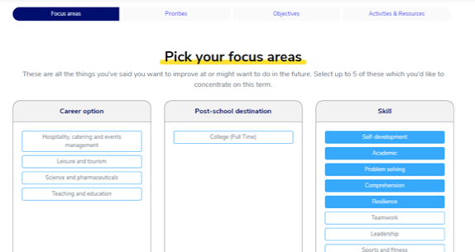
2 minutes
Next step: making a plan
Decide what you want to focus on
Now you need to create your Plan. Follow the online instructions to choose 5 areas you want to focus on and then drag them into priority order.
Notes:
Teacher Notes
- Questioning: ask students to volunteer to tell you the areas they want to work on and why they have chosen to prioritise them in that order.

Slide 14

5 minutes
Next step: making a plan
Set your objectives
Now you have decided what you want to work on, what are you going to do to improve?
What does a good objective look like?
For a student that wanted to find out about university:
I will pick one university and research three courses I think sound interesting
I will do some research into university
I will go to university
Notes:
Teacher Notes
- Questioning: ask students to provide some good/bad examples for different areas they may have chosen.

Slide 15
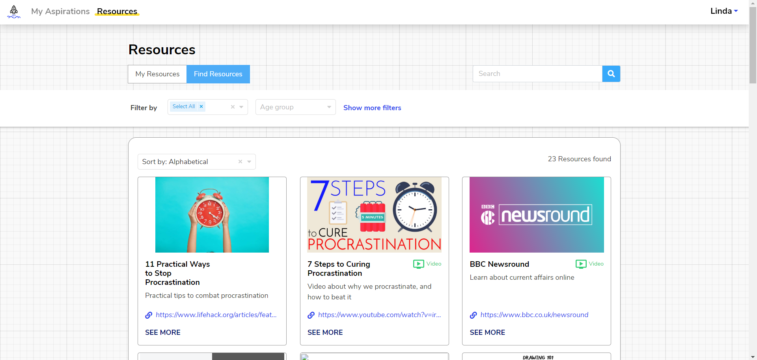
5 minutes
Finally, choose some resources
Find some activities and online resources
Now you have written your objectives, it’s time to start finding some help to achieve them!
Look through the suggested school activities,
resources and websites, and click to ‘Add to
your plan’ any you think look suitable.
Full programme only
Notes:
Teacher Notes
- Ask students if there are any clubs they would like to do that are not offered at the moment and ask them to write them into the platform.

Slide 16
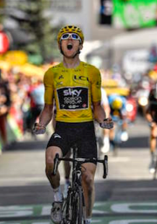
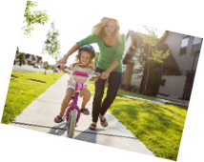
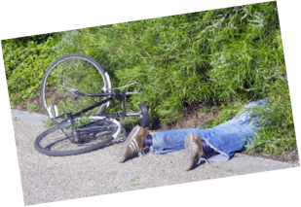
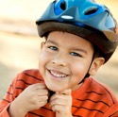
Be warned: getting good at self-development isn’t easy…
It feels like developing any new skill – like riding a bike
This is going to be FUN!
Oh no... This wasn’t the plan…
OK, getting there, with a bit of help…..
Smashed it!
This is really hard… I can’t do this!
Notes:
Teacher Notes
Finish the lesson by asking students to share an objective from their plan and what they are going to do in the immediate future to work towards their own personal development.

